Slide 1

HCI - Assignment n.2
Design and prototyping of an application using a human-centered approach
Deliverable nº 1: Requirement Analysis
Project Title: StudySync
Group: Gonçalo Cunha nº108352 , José Cerqueira nº76758, Vasco Rodrigues nº109211
Lab Class: P2
HCI 2023-2024

Slide 2
Introduction
StudySync
StudySync is a tailored solution for university students seeking effective time management and organization.
We've experienced firsthand the struggle of balancing academic demands with personal commitments. StudySync addresses this challenge head-on, providing intuitive tools for scheduling, task management and progress tracking.
StudySync lies in its potential to enhance student success and well-being.
HCI 2024-2024
2

Slide 3
Project Objectives
StudySync
Goals: Simplify academic scheduling and task management - Provide students with intuitive tools for organizing their academic responsibilities effectively.
Outcomes: Foster increased accountability, better time management, and improved academic performance
Benefits: Enhance efficiency, convenience and empowerment.
HCI 2024-2024
3

Slide 4

Personas
Eusébio, 20
2nd year Physics student with bad time awareness
Problems – Forgets exam dates and project deadlines
Goals – Prepare for exams ahead of time and improve project deadlines management
Needs – To be able to create a study plan, set up deadlines and priorities for each task, track her progress and evaluate her performance.
HCI 2023-2024
4

Slide 5
Scenarios
StudySync
Scheduling study plan for test - Eusébio
Wants to plan a progressive study plan with notifications to remind him of any deadlines.
Improve attendance - Rita
Wants to became a better student by not missing any class, and needs a reminder to focus and motivate her.
HCI 2023-2024
5

Slide 6
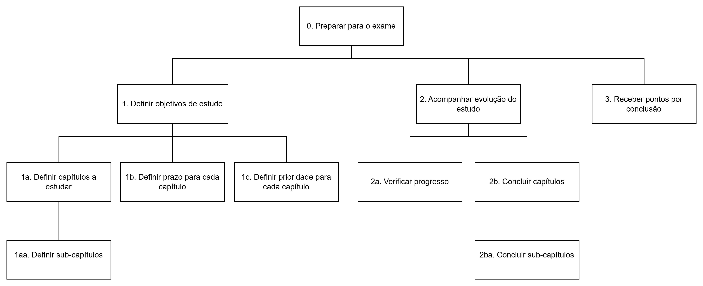
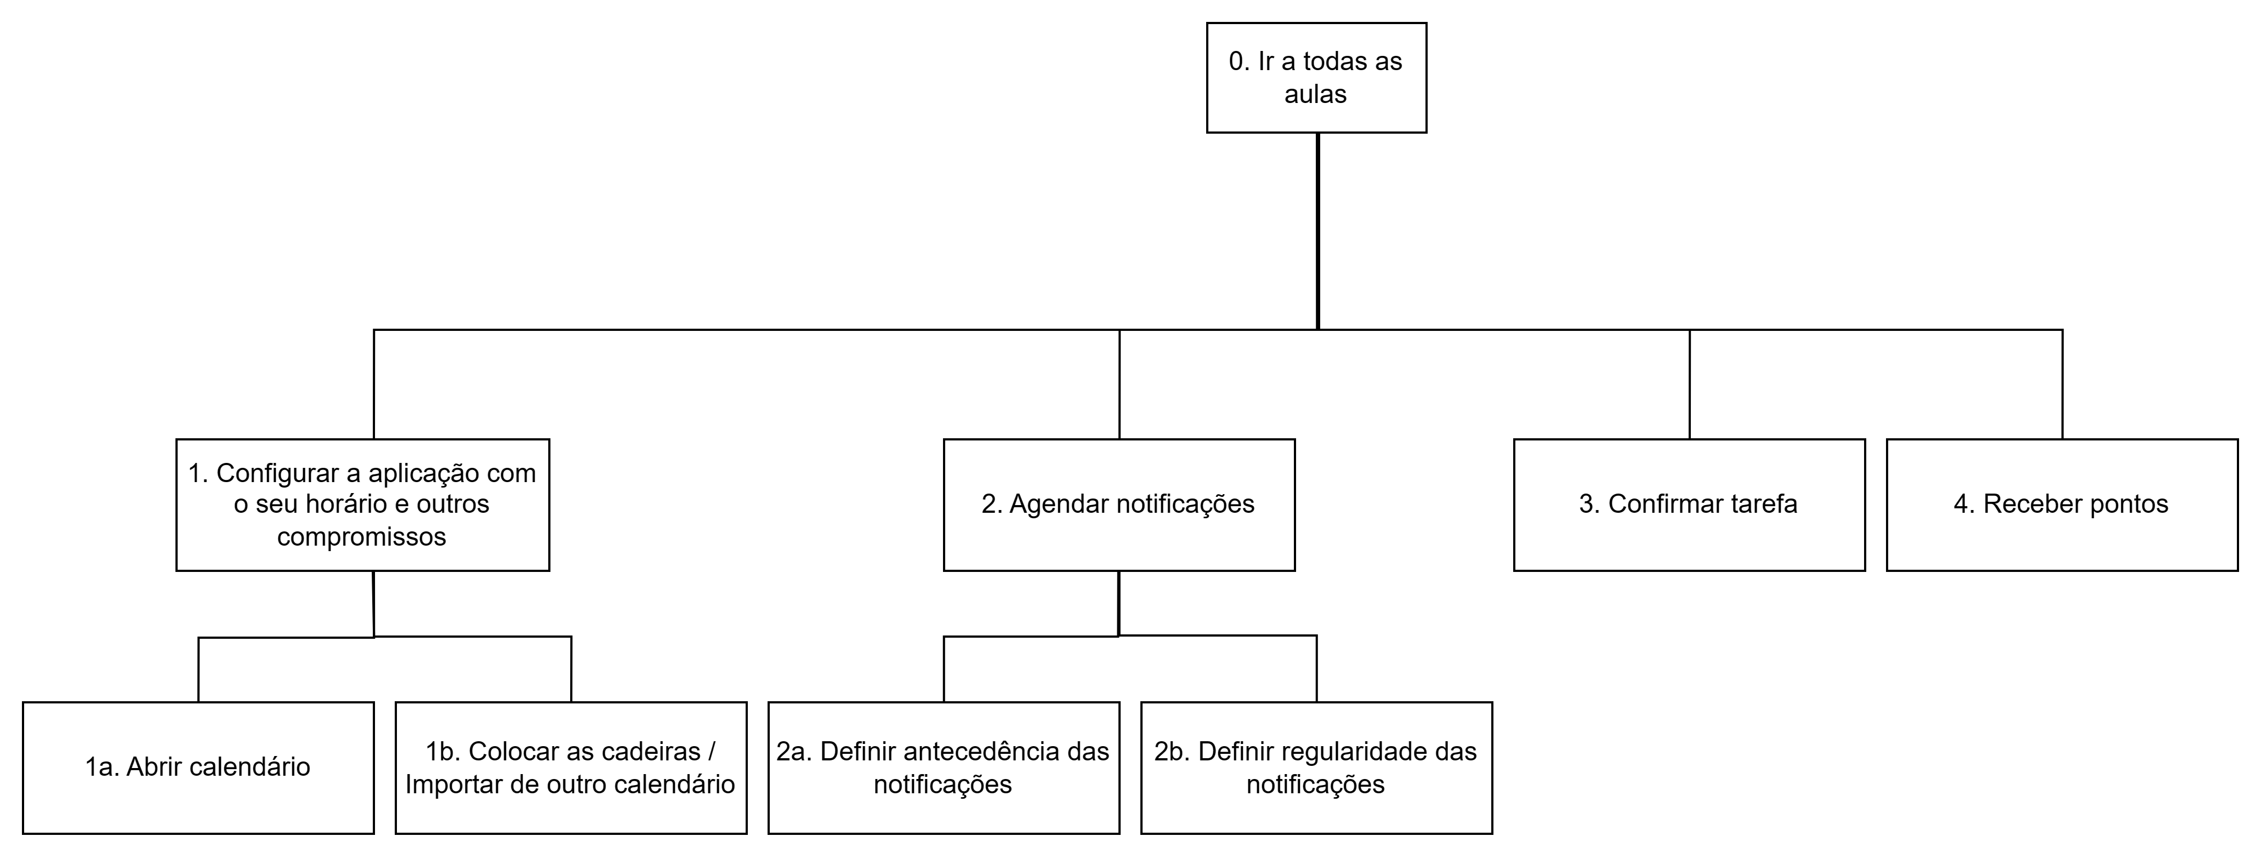
Tasks
StudySync
HCI 2023-2024
6

Slide 7
Requirements
StudySync
Functional requirements
Create and manage school calendar
Reward user for accomplishing tasks/objectives
Schedule and receive alerts for exams and projects
Create tasks, subtasks and multi-step tasks and mark them as completed
Set goals e check weekly and monthly stats
Catalog and check classes, grades and fees
Define the class schedule and check into classes
HCI 2023-2024
7

Slide 8
Requirements
StudySync
Non-functional requirements
Recoverability – ensures that the app can recover all the data after the system failure or restore the system to certain parameters;
Scalability – determines that the app will continue functioning properly after its size or volume changes;
Usability – defines how easy a user can interact with the app’s interface, e.g. the screen color, buttons size, etc.;
Capacity – assesses the amount of data or services the app can handle
Security – defines how secure the app should be
HCI 2023-2024
8

Slide 9
HCI - Assignment n.2
Design and prototyping of an application using a human-centered approach
Any questions?
Project Title: StudySync
Group: Gonçalo Cunha nº108352 , José Cerqueira nº76758, Vasco Rodrigues nº109211
Lab Class: P2
HCI 2023-2024

